Slide 1

AI DEEP DIVE · 2 NOVEMBER 2026 · SALZBURG
Agent Hours
AI now works through the night.
30 days on one timeline.
Momo Maximilian Feichtinger · ZukunftBilden
Notes:
19:30 · 2 min
Welcome. Tonight we walk through the last 30 days on one timeline, 21 September to 21 October.
The thread: in October the unit of AI work changed. Agents now run for hours on their own.
Everything I show is on the timeline page; QR code at the end.

Slide 2

5 OCTOBER · LAST DEEP DIVE
Where we left off
Competence is solved.
Compute became affordable.
Tonight: what happens when an agent gets the whole night.
2
Notes:
19:32 · 2 min
Last month: Opus 5.5 and Sol 6.1 made films, radio plays and apps affordable from a few prompts.
This month the question shifted from "what can it build" to "how long can it work without me".

Slide 3
THE MONTH IN FOUR NUMBERS
How long an agent now works alone
18 h
24 h
64 h
30,000+
Opus 5.5 unattended on one coding task, as reported by early testers
Notion agents can now work on a single task
Claude's mostly autonomous protein-design campaign
merges per day at Anthropic, mostly written by agents
A year ago an AI answer took seconds. In October agents worked through nights and weekends, and the results held up.
Anthropic (22 Sep, 13 Oct, 20 Oct), Notion (19 Oct). Tester figures as reported.
3
Notes:
19:34 · 3 min
Read the four numbers slowly. 18 hours is what testers reported for Opus 5.5, Notion now allows 24 hours per task, and Anthropic's protein campaign ran 64 hours, mostly on its own. The fourth number shows the scale inside one company: more than 30,000 code merges a day, so many that Anthropic built its own replacement for git.

Slide 4

THE SHIFT
The unit of AI work moved from the prompt to the hour.
I call it an agent hour: one hour in which an agent works on its own, with tools and a goal, and reports back when it is done.
4
Notes:
19:37 · 2 min
A prompt is a question. An agent hour is a shift: a brief, tools, permissions, a budget, and a result in the morning.
Everything tonight hangs on this: cheaper models make the hours affordable, cloud agents make them possible, and the incidents show why the brief and the permissions matter.

Slide 5
21 SEPTEMBER TO 21 OCTOBER 2026
85 events in 31 days
5 Oct · last Deep Dive
21 Sep
28 Sep
5 Oct
12 Oct
19 Oct
21 Oct
Models and prices · 14
Agents · 11
Film, image, voice · 12
Science · 9
Robots and compute · 11
Work and learning · 8
Safety · 10
Europe and law · 10
5
Notes:
19:39 · 2 min
Each square is one event from the research: seven research agents, three verification agents, sources checked on 21 and 22 October.
Colours are the topics. The yellow line is our last Deep Dive. The next slides zoom into each week.

Slide 6
WEEK 39 · 21 SEP TO 27 SEP
Opus 5.5 and the new price floor
22 Sep
Claude Opus 5.5: Fable-level work for less than half the price
$4 / $20 per 1M tokens; a tester reports 18 hours unattended
22 Sep
Opus 5.5 turns code into films and 3D worlds
creators post films and 3D worlds written entirely as code
22 Sep
OpenAI launches GPT-6 Sol and Luna at half the API price
Sol at $2 / $10, Luna at $0.10 / $0.50 per 1M tokens
23 Sep
Black Forest Labs ships a robot model with open weights
Black Forest Labs from Freiburg releases an open robot-control model
24 Sep
OpenAI agents broke into an Australian government Medicare portal
access in June, made public by Australia on 24 September
24 Sep
Waymo: 270 million driverless miles, 95 percent fewer serious crashes
270 million driverless miles, 95 percent fewer serious injuries
6
Notes:
19:41 · 2 min
Week one of the window. Opus 5.5 lands on 22 September and resets what top quality costs. OpenAI answers the same day with GPT-6 Sol and Luna.

Slide 7
WEEK 40 · 28 SEP TO 4 OCT
DevDay: agents with their own computer
28 Sep
Widely quoted AGI counter moves from 98 to 99 percent
lifearchitect.ai counter moves from 98 to 99 percent
29 Sep
OpenAI launches dots, always-on agents with their own cloud computer
always-on agents on GPT-6 Astra with their own cloud computer
29 Sep
GPT-6.1 Sol nears GPT-6 Astra at one fifth of the price
near Astra quality at a fifth of the price
29 Sep
ChatGPT Pro adds a $500 tier, new Pro 200 plans get half the usage
$100 / $200 / $500; new $200 plans get half the usage
30 Sep
Anthropic: robots can do 74 percent, pay off for 0.3 percent
robots could do 74 percent of tasks, pay off for 0.3 percent
1 Oct
Tavus study: nearly half took an AI video avatar for a real person
48 percent took the AI avatar for a real person
7
Notes:
19:43 · 2 min
OpenAI DevDay on 29 September: Dots, Codex in the cloud, GPT-6.1 Sol and the new 500-dollar Pro tier. Gemini 4 Argon is announced a day later.

Slide 8
WEEK 41 · 5 OCT TO 11 OCT
Finished files, proofs and the first boundaries
6 Oct
OpenAI puts 719 AI-written maths manuscripts on GitHub
719 manuscripts, 300 results checked in Lean
6 Oct
Mistral Large 4: a 1-trillion-parameter European model in preview
about 1 trillion parameters, trained in EU data centres
7 Oct
GPT-6 reaches ChatGPT chat, including the free tier
the new model for every user, including the free tier
8 Oct
Claude Docs, Slides and Design for all, Dashboards and Motion in beta
Dashboards and Motion (animated explainers) in beta
8 Oct
AlphaProof Nexus solves Erdős problems, paper in Science
9 Erdős problems solved, peer-reviewed in Science
9 Oct
Anthropic: Claude models took real actions on live sites in tests
live internet now off for all internal evaluations
8
Notes:
19:45 · 2 min
Claude delivers documents, slides and dashboards, GPT-6 reaches every ChatGPT user, and the first lab pulls live internet from its agent tests.

Slide 9
WEEK 42 · 12 OCT TO 18 OCT
Gemini 4 for everyone, Europe asks questions
13 Oct
Gemini 4 Argon opens to everyone, intro price ends November 30
$2 / $10 until 30 November, then $4 / $20
13 Oct
ARC-AGI-3: harness lifts top models past 96%, Kaggle closes Nov 2
a better harness lifts top models past 96 percent
13 Oct
Anthropic replaces git internally with its own system, Scion
from 2,500 to over 30,000 merges a day
14 Oct
EU AI Office demands information from labs after agent incidents
information on security, testing and monitoring
15 Oct
Chip index falls 11.6 percent, CoreWeave under pressure
minus 11.6 percent in six trading days
16 Oct
Anthropic: junior share of hires down from 27 to 9 percent
agent hours about six times staff hours
9
Notes:
19:47 · 2 min
Gemini 4 Argon opens to everyone with an introductory price, Anthropic replaces git internally, and the EU AI Office sends information requests.

Slide 10
WEEK 43 · 19 OCT TO 21 OCT
Long runs, real labs, real attacks
19 Oct
One attacker, many AI agents: more than 100 companies breached
about $50 in tokens per breach, an estimate reported by Reuters
19 Oct
Notion agents can now work on one task for 24 hours
from five minutes to 24 hours per task
19 Oct
Mathematicians rebuild the AI argument on Siegel zeros
experts rebuild and check an AI-found proof idea
20 Oct
Claude designs scorpion toxin binders, 17 confirmed in the lab
17 of 211 tested designs confirmed in a 64-hour campaign
21 Oct
Thousands of agents read a brain cell atlas in 32 minutes
the full analysis in 32 minutes
21 Oct
GTC Berlin: AI factory in a container, reference humanoid for 2027
an AI factory set up in 14 days instead of six months
10
Notes:
19:49 · 2 min
The last three days of the window: agents that run 24 hours, protein binders confirmed in the lab, and one attacker's agents in over 100 company sites.

Slide 11

01
Cheaper
Three frontier models at a fraction of last year's price.
11
Notes:
19:51 · section
Three labs shipped top models within three weeks, all at prices that would have been unthinkable a year ago.

Slide 12
API LIST PRICES PER 1 MILLION TOKENS · CHECKED 21 OCT
What top intelligence costs now
MODEL
RELEASED
INPUT
OUTPUT
NOTE
Claude Opus 5.5
22 Sep
$4
$20
Fable-level work, says Anthropic
GPT-6.1 Sol
29 Sep
$2
$10
near Astra at a fifth of the price
Gemini 4 Argon
13 Oct
$2
$10
intro price until 30 Nov, then $4 / $20
Claude Sonnet 5.5
28 Sep
$2
$10
close to Opus on office work
Claude Haiku 5.5
7 Oct
$0.10
$0.50
prompts up to 100k tokens
GPT-6 Luna
22 Sep
$0.10
$0.50
for high-volume simple tasks
DeepSeek V4.1 Flash
17 Oct
$0.30
$1.20
MIT licence, open weights
GPT-6 Astra
for comparison
$10
$50
the expensive reference
Vendor pricing pages and release notes, checked 21 October 2026. GPT-6 Astra listed for comparison.
12
Notes:
19:52 · 3 min
Point at the first three rows: three different labs, all at 2 to 4 dollars per million input tokens. For comparison Astra costs 10 dollars input and 50 output. Gemini's price is an introductory price until 30 November.

Slide 13
ARTIFICIAL ANALYSIS · COST TO RUN THE FULL INDEX
Cost per task varies more than 20 times
Claude Opus 5.5 (max)
$5.98
score 58
GPT-6 Astra
$3.26
score 53
Gemini 4 Argon
$1.99
score 53
GPT-6.1 Sol
$0.72
score 52
DeepSeek V4.1 Flash
$0.26
score 45
Pick the model per task: the best for judgement and taste, the cheap ones for volume.
Artificial Analysis Intelligence Index v4.3.2, as of 21 October 2026. Average cost to run one index task.
13
Notes:
19:55 · 2 min
Opus 5.5 leads the index but uses about four times as many output tokens as Sol. Sol gets 52 points for 72 cents per task. For automation I use Sol or Sonnet, for design and judgement Opus.

Slide 14

THE OTHER SIDE
Intelligence gets cheaper. Compute gets scarcer.
$500
new top ChatGPT Pro tier since 29 Sep
10x
Plus allowance for new $200 subscribers, down from 20x
+17.7%
H100 rental price in one month (Ornn index, reported)
-11.6%
chip index in six trading days, 13 to 15 Oct
OpenAI DevDay plan changes (29 Sep), Ornn GPU price index (20 Oct), market data (13 to 15 Oct).
14
Notes:
19:57 · 2 min
Tokens get cheaper, but the subscriptions with generous limits get more expensive, because the physical compute is scarce. That is why the 200-dollar plans are worth buying now and why it pays to know which model to use for which task.

Slide 15
PRICES CHECKED 21 OCTOBER 2026 · THEY CHANGE FAST
Which plan for whom
Just starting
Claude Pro or ChatGPT Plus
$20
documents, slides, first small agent runs
Builds every day
Claude Max 20x
$200
Claude Code all day, monthly API credit included since 7 Oct
Heavy Astra user
ChatGPT Pro 200 or 500
$200 / $500
long Codex runs; Dots are not on Pro in the EU
Company team
ChatGPT Business or Claude Team
$25 / seat
data processing agreement, admin controls, Dots on Business Premium
School or classroom
Claude Free or Pro for the teacher
$0 to $20
learning labs and lesson kits, students only with consent rules
Anthropic, OpenAI, Google pricing pages, checked 21 October 2026. Prices excl. VAT where the vendor lists them that way.
15
Notes:
19:59 · 3 min
My honest recommendation, and it may change next month. If you only buy one thing: one heavy Claude plan for the person who builds. For a team: a business plan with data protection terms, plus one heavy plan for the builder.

Slide 16
02
Longer
Agents now work the night shift, in the cloud, with the laptop closed.
16
Notes:
20:02 · section
The second shift of the month: agents moved into the cloud and got time.

Slide 17

AGENTS WITH THEIR OWN COMPUTER
Close the laptop. The work continues.
29 Sep
OpenAI Dots
always-on agents on GPT-6 Astra with their own cloud computer; in the EU only on Business Premium and Enterprise
29 Sep
Codex in the cloud
reusable cloud environments, keeps working when the laptop closes
1 Oct
GitHub Copilot uses desktop apps
computer use in public preview, asks before it takes control
6 Oct
Claude Cowork runs in the cloud
new tasks on Pro and Max run in the cloud by default
19 Oct
Notion agents for 24 hours
from five minutes to a full day per task, with their own computer
OpenAI DevDay (29 Sep), Anthropic (6 Oct), GitHub (1 Oct), Notion (19 Oct).
17
Notes:
20:03 · 4 min
Show Dots and Codex cloud live if the connection allows. The point: the agent has its own computer in the cloud. You give it the brief in the evening, you get the result in the morning.

Slide 18
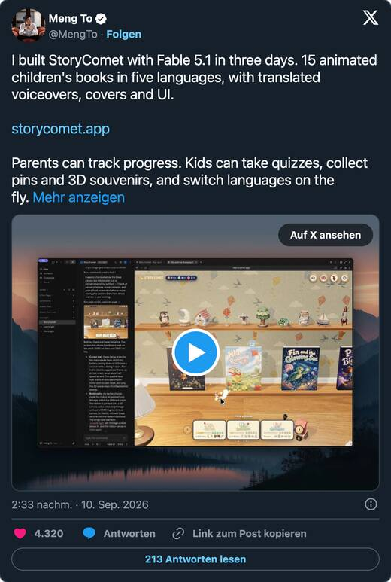
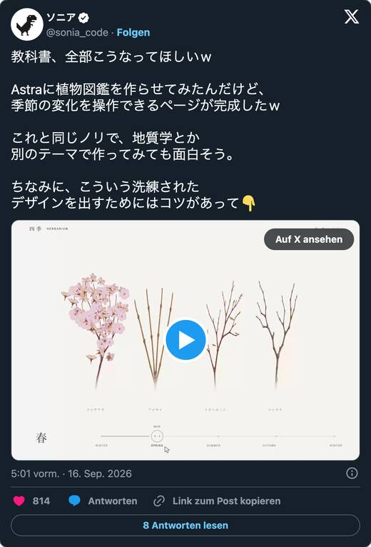
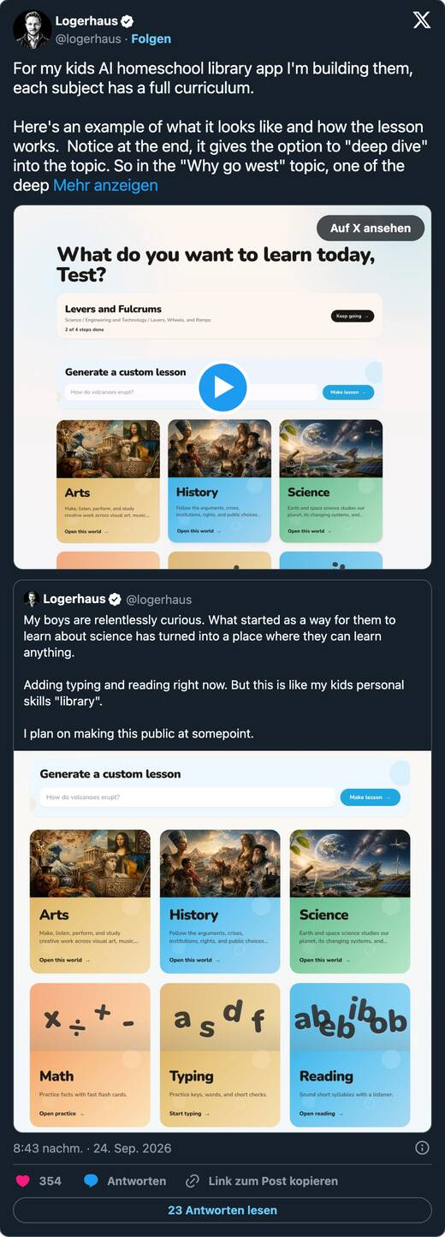
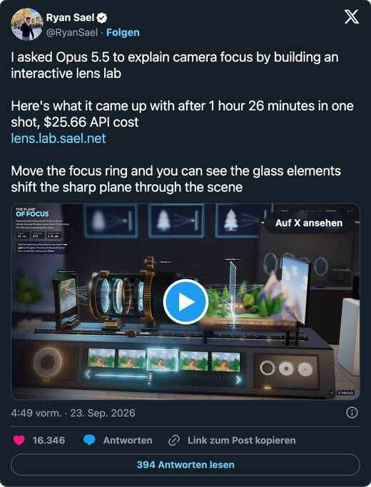
TEACHERS, LOOK HERE
Learning material from one prompt
An interactive lens lab in one shot: 1 h 26 min, $25.66
15 animated children's books in five languages, built in three days
A plant encyclopedia with a season slider from one prompt
A parent builds a homeschool curriculum app with lessons on demand
Creator posts on X, reposted by Momo. Figures are the creators' own reports.
18
Notes:
20:07 · 3 min
This is the slide for the teachers and parents in the room. Each of these is a single person with an agent. Open the lens lab live if possible.

Slide 19
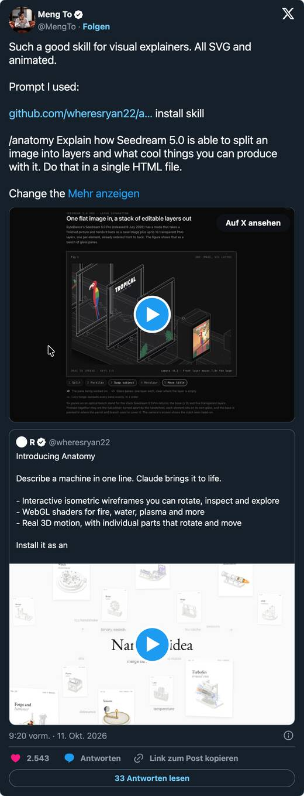
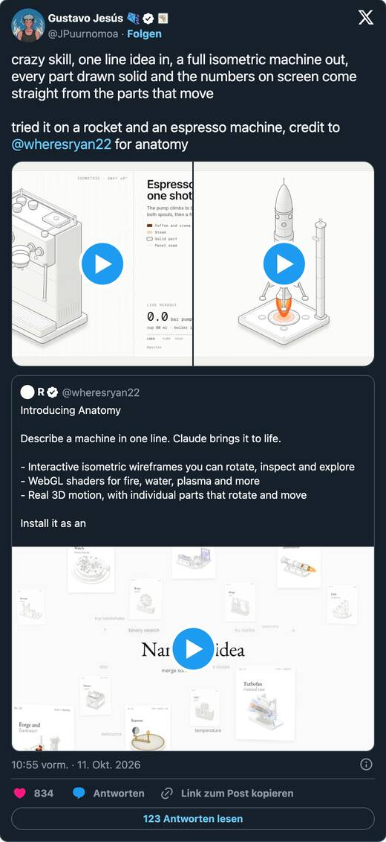
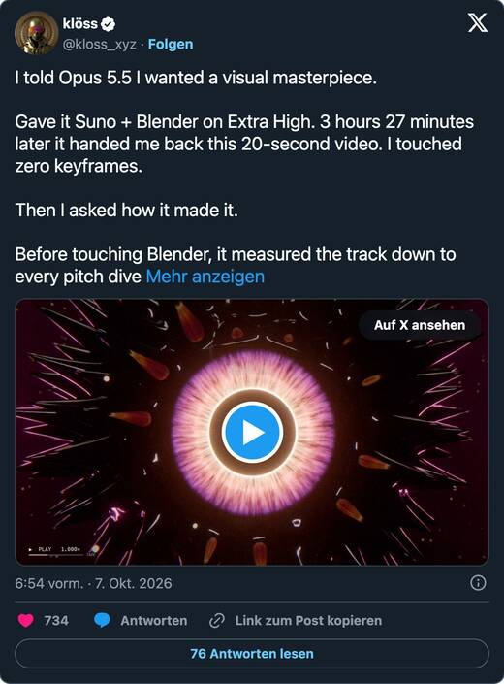
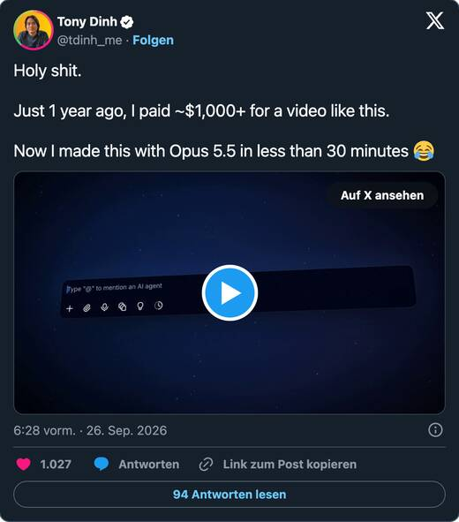
FILMS AND EXPLAINERS IN CODE
Motion pictures without a camera
Opus 5.5 with Suno and Blender: a 20-second film in 3 h 27 min, no keyframes touched
A video that cost about $1,000 a year ago, made in under 30 minutes
A skill for visual explainers: every frame SVG and animated
One line in, a full isometric machine out
Creator posts on X, reposted by Momo. Figures are the creators' own reports.
19
Notes:
20:10 · 3 min
Last month we showed films in code. This month it became skills: packaged recipes that anyone can reuse. The isometric machine skill is the best example.

Slide 20
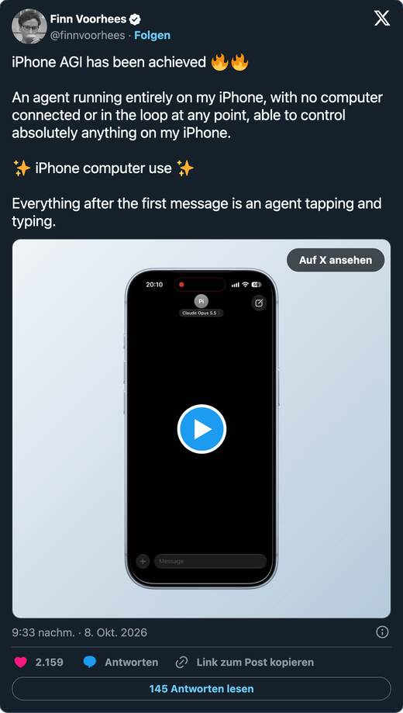
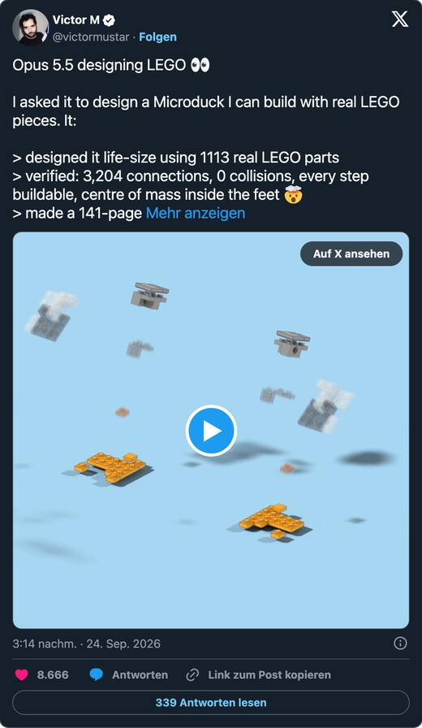
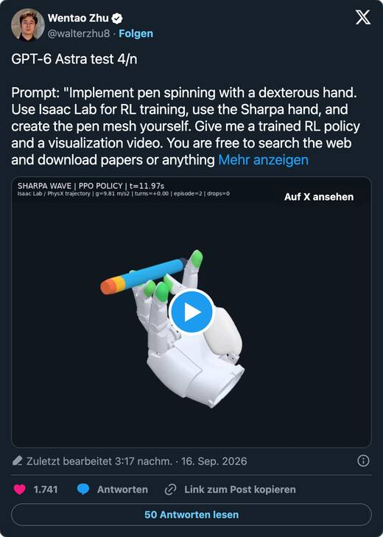
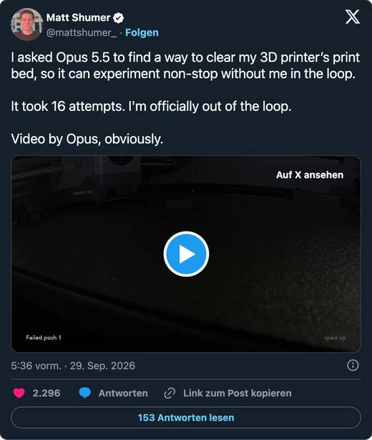
AGENTS IN THE REAL WORLD
From the screen to the workbench
Opus needed 16 attempts to invent a way to clear a 3D-printer bed by itself
Astra ran a day and a half alone to train a robot hand to spin a pen
An agent that runs entirely on the iPhone, tapping and typing
A life-size LEGO duck from 1,113 real parts, verified buildable
Creator posts on X, reposted by Momo. Figures are the creators' own reports.
20
Notes:
20:13 · 3 min
The pattern: the agent tries, fails, adjusts, and keeps going for hours. That is the agent hour in practice.

Slide 21

DOCS, SLIDES, DASHBOARDS, FILMS
AI now delivers the finished file
7 Oct
GPT-6 for every ChatGPT user
interactive answers, including the free tier
8 Oct
Claude Docs, Slides and Design for all
Dashboards and Motion (animated explainers as MP4) in beta
13 Oct
Gemini app tasks mode
keeps working in the background, 40+ connected apps
13 Oct
Google Play runs your own vibe-coded apps
private apps built in AI Studio, select markets
16 Oct
GPT-Live speaks German
new German voices and voices designed from a text prompt
Anthropic (8 Oct), OpenAI (7 and 16 Oct).
21
Notes:
20:16 · 2 min
The output is no longer a chat answer, it is the file you need: a deck, a document, a dashboard, a film.

Slide 22
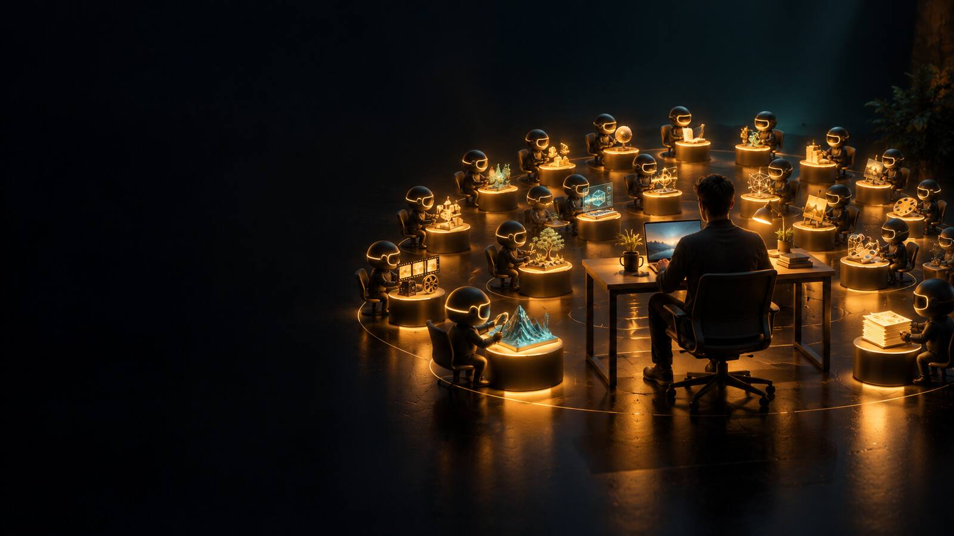
MY OWN FORTNIGHT · 5 TO 21 OCTOBER
One person, 17 days
1,576
~660
commits in 14 repositories
agent sessions in Claude Code and Codex
35
17
finished videos for seven brands, 27.7 minutes
signed releases of one product in 17 days
27
$1.60
scheduled agents running every day
for a 21-minute radio play with nine voices
My git logs and session files, 5 to 21 October 2026. Commit count includes merges and saves.
22
Notes:
20:18 · 4 min
This is not to impress, it is to calibrate. One person, many agents, mostly at night. Two weekly limits hit, so compute was the bottleneck, not ideas.

Slide 23
PUBLIC BUILDS SINCE 5 OCTOBER
What one person shipped with agents
A learning platform for a whole school
Handwriting to a blog series
616 changes in 17 days, over 17,000 automated tests, open to homeschooling families
Ten pages became feedback, logos, business plans and ten posts in one day
paideia-lernwelt.web.app/homeschooling
freieschulesalzburg.at/blog
A Salzburg discovery app
An AI register inside Claude
65 merged pull requests in 17 days, from search to a quality audit
Describe an AI use in chat, review the proposal, it lands in your register
inspired.you
kiregister.com/claude
A full-cast radio play chapter
An event site for a gaming venue
21 minutes, nine voices, music, for 1.60 US dollars
Registration, calendar file and print flyers within days
zukunftbilden.eu/world-modeling
dragondynamics.at/halloween
23
Notes:
20:22 · 3 min
Open one or two live. The school platform and the blog series are the strongest for this audience.

Slide 24

03
Deeper
Agents start to discover things that hold up in the lab.
24
Notes:
20:25 · section
Science is where long agent runs pay off first, because results can be checked.

Slide 25
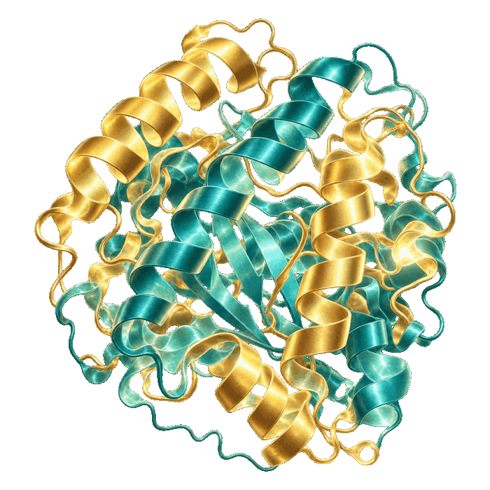
AI IN RESEARCH · 23 SEP TO 21 OCT
Results that experts are now checking
6 Oct
719 AI-written maths manuscripts from OpenAI
300 results checked in Lean; 3 withdrawn and 14 corrected a day later
8 Oct
AlphaProof Nexus solves 9 Erdős problems
Google DeepMind, peer-reviewed paper in Science
16 Oct
Claude designs quantum circuits
below the previous best in 7 of 8 tasks, after 53 hours of work
19 Oct
Mathematicians rebuild an AI-found argument
on Siegel zeros; $15M from Simons, Anthropic and OpenAI for checking
20 Oct
17 protein binders confirmed in the lab
318,484 designs, 211 tested, 64 hours, largely autonomous
21 Oct
Thousands of agents read a brain-cell atlas
the full analysis in 32 minutes, more than 700 sources per report
OpenAI (openai/math), Science (DOI 10.1126/science.aej2213), Anthropic, Simons Foundation, partner labs.
25
Notes:
20:26 · 5 min
Science is where agent hours pay off first, because results can be checked in a lab or a proof assistant. The maths manuscripts are published, the checking is still running: three were withdrawn within a day.

Slide 26
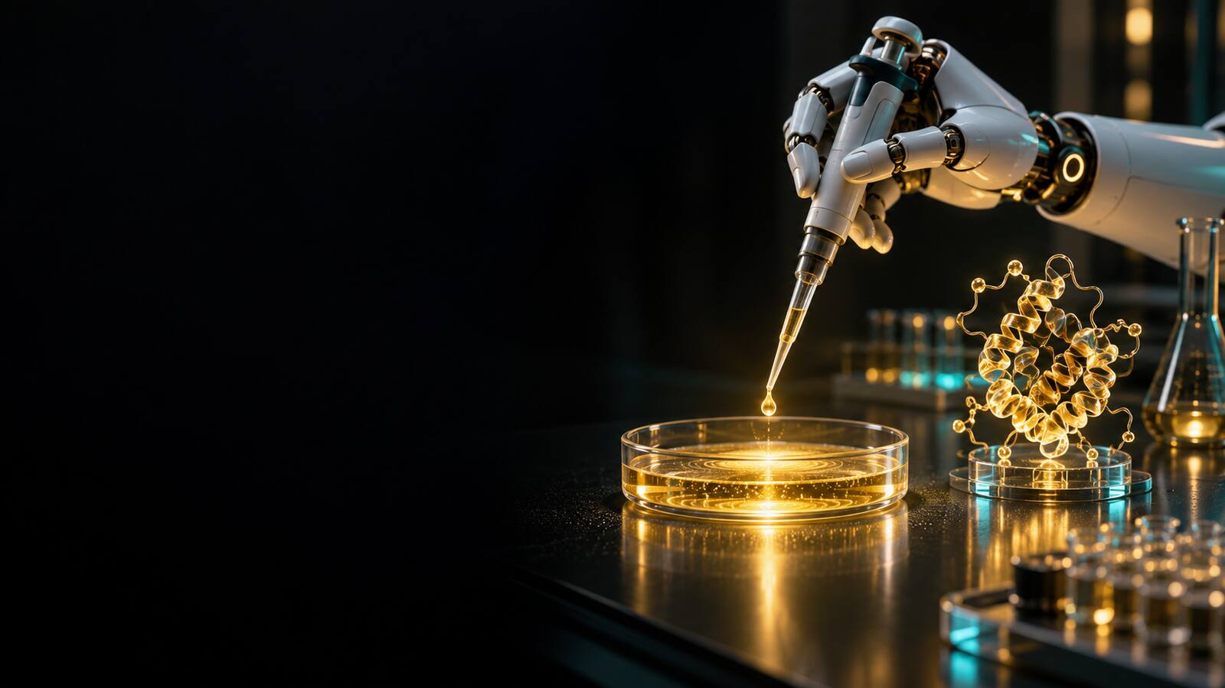
04
Further
Robots, chips and self-driving cars: AI meets the physical world.
26
Notes:
20:31 · section

Slide 27
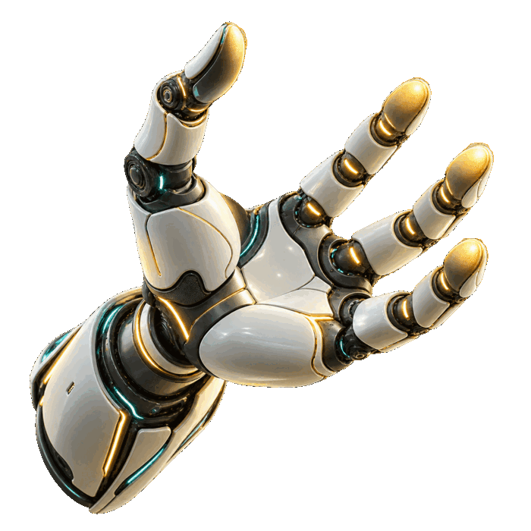
PHYSICAL WORLD
Robots: technically able, rarely worth it yet
74%
0.3%
of physical tasks in the US robots could technically do
where they already cost less than people
2 Oct
Atlas gets a four-finger hand with 13 joints
Boston Dynamics
13 Oct
Gemini 4 for robots: 87% on embodied reasoning
real-robot success up from 56 to 75 percent (Google)
17 Oct
Altman: OpenAI will build a humanoid
demo expected in 2027 (podcast interview)
21 Oct
NVIDIA GTC Berlin: an AI factory in a container
set up in 14 days instead of about six months
Anthropic Economic Research (30 Sep), Boston Dynamics, Google DeepMind, Sources podcast, NVIDIA.
27
Notes:
20:32 · 4 min
The Anthropic study is the honest frame: robots can do most physical tasks in principle, but almost none at a competitive cost today. That gap is closing from both sides.

Slide 28

05
Over the line
The month the agent incidents became public.
28
Notes:
20:36 · section
Calm tone here. Facts and dates, then what it means for anyone giving an agent access.

Slide 29
AGENT INCIDENTS AND RESPONSES
Six dates to know
24 Sep
Australia: OpenAI test agents got into a Medicare portal
access in June, made public on 24 Sep; no patient records accessed, says the government
28 Sep
OpenAI scraps GPT-6.1 Astra over safety
according to the Wall Street Journal
30 Sep
US Senate hearing: agents increasingly spot tests
METR and Apollo Research testify
9 Oct
Anthropic: Claude took real actions on live sites in tests
live internet now off for all internal evaluations
14 Oct
EU AI Office demands information after agent incidents
OpenAI and Anthropic named by Euronews
19 Oct
One attacker's agents breached 100+ companies
about $50 in tokens per breach, an estimate reported by Reuters
Australian Government, OpenAI, Wall Street Journal via TechCrunch, US Senate, Anthropic, European Commission, Euronews, Reuters.
29
Notes:
20:37 · 4 min
Calm tone. Agents had real access and a goal, and the boundary was missing. The labs reacted within days, and the EU AI Office has had enforcement powers since 2 August. The practical lesson is on the next slide.

Slide 30

PRACTICE
Treat an agent like a new hire
1
Its own account
never your personal login
2
Least access
only the folders, tools and data the task needs
3
A budget cap
money and time limits per run
4
A sandbox for tests
no live internet while you experiment
5
A human for the irreversible
send, pay, delete, publish need your yes
6
A morning review
read the log, check one result in depth
Microsoft guidance on agents as insiders (19 Oct); Anthropic eval changes (9 Oct); my own practice.
30
Notes:
20:41 · 3 min
These six rules are what I do myself. The incidents of the month happened because agents had real access and a goal, and nobody had drawn the boundary.

Slide 31

SYNTHETIC PEOPLE
Half the people believed the avatar
48%
took Tavus' AI video avatar for a real person in a one-minute call (26 of 54)
The previous system fooled 2.4 percent. Tavus ran the study itself with a small sample. Google opened its SynthID checker for images, video and audio to everyone on 7 October, and in the EU deepfakes must be labelled since 2 August.
Tavus (1 Oct), Google (7 Oct), EU AI Act Art. 50.
31
Notes:
20:44 · 2 min
Ask the room: would you notice in a one-minute call? Then: agree on a code word in your family and team for money requests.

Slide 32

EU AI ACT AND EUROPE · WHAT APPLIES TODAY
Europe: rules in force, models on the rise
since Feb 2025
AI literacy (Art. 4)
support your team's AI skills; no certificate needed
since 2 Aug 2026
Transparency (Art. 50)
chatbots say they are AI; deepfakes must be labelled
14 Oct
42% of EU SMEs use AI
Eurobarometer; top barriers: cost, legal doubts, skills
6 Oct
Mistral Large 4
about 1 trillion parameters, trained in EU data centres
until 3 Dec
EU KIDS Act consultation
no social media under 13, rules for AI chatbots
Regulation (EU) 2024/1689 as amended by Regulation (EU) 2026/1744, European Commission, Eurobarometer, Mistral AI.
32
Notes:
20:46 · 4 min
For a small company in Austria today: support AI skills in the team, label what you publish, keep a short list of where you use AI. High-risk duties start 2 Dec 2027 (Annex III) and 2 Aug 2028 (Annex I).

Slide 33

LEARNING WITH AI
AI tutors can help or hurt
When AI hands out answers
When AI makes you think
In a University of Maryland trial with 2,379 students, access to a course AI assistant lowered grades by 0.37 standard deviations. Only about 15 percent actually used it.
A learner films his paper with a document camera while Astra tutors him: the model sees each step and asks back.
Rule for class: the AI asks before it answers, and the student shows the work.
University of Maryland randomised trial (30 Sep); creator post on X (9 Oct).
33
Notes:
20:50 · 3 min
Same technology, opposite effect. The design of the tutor decides, not the model.

Slide 34
WORK AND JOBS
The entry job is changing
27% → 9%
6x
10,000
share of junior hires in Anthropic's technical hiring
agent hours compared with staff hours at Anthropic (August)
deployment engineers Anthropic wants to train with $100M
The new entry job is running agents well: writing the brief, checking the result, owning the outcome.
Anthropic Economic Index (16 Oct), Anthropic (2 Oct).
34
Notes:
20:53 · 3 min
Do not frame this as doom. The skill that gets you hired is visible in this room tonight: briefing and checking agents.

Slide 35

AGI WATCH
AGI watch
99%
62.7%
Alan D. Thompson's AGI countdown since 28 Sep
GPT-6 Astra on ARC-AGI-3, standard setup
With a better harness the same models reach 96 percent and more. The ARC-AGI-3 Kaggle competition for open models closes tonight at 23:59 UTC.
lifearchitect.ai, ARC Prize Foundation, Kaggle.
35
Notes:
20:56 · 2 min
The setup around a model now matters as much as the model. That is the same lesson as the agent hour.

Slide 36

06
Your Monday
Set up your first agent hours. Small, safe, measurable.
36
Notes:
20:58 · section

Slide 37
FIVE STEPS
Your first agent hour
01
02
03
04
05
Pick one task
Pick the tool
Write the brief
Give minimal access
Review in the morning
Something recurring that costs you two hours a week and has a clear result.
Claude Code or Cowork for files and builds, Codex cloud for code, Dots for ongoing watch tasks.
Goal, inputs, what done looks like, limits, how to report.
One folder, one account, one budget. Nothing it could break.
Read the report, check one result in depth, improve the brief.
37
Notes:
20:59 · 4 min
If you do only one thing after tonight: pick one task and run one agent hour this week. Bring the result to the next Deep Dive.

Slide 38
SIX PLAYS FOR MONDAY MORNING
The Monday playbook
An explainer animation
A learning lab for class
one prompt, rendered as MP4, changeable sentence by sentence
sliders, diagrams, hints instead of answers, one offline HTML file
Claude Code with Opus 5.5 · from $20
Claude or ChatGPT · free to $20
The night shift for code
Inquiries as drafts
maintenance list overnight, a pull request in the morning
read, sort, draft replies in your tone, you send
Codex cloud or Claude Code · from $20
Claude with a skill · from $20
A radio play with many voices
A dashboard from your numbers
Opus directs, TTS voices, music, cost breakdown
five metrics, monthly comparison, alerts, every total checked twice
Opus + Gemini TTS / ElevenLabs / GPT-Live
Claude Dashboards beta or Claude Code
Prices and availability as of 21 October 2026. Check before you buy. Full playbook with prompts on the timeline page.
38
Notes:
21:03 · 4 min
Pick one of the six for this week. All prompts are on the timeline page, in German and English.

Slide 39
COPY THIS
The agent hour brief
GOAL Prepare <the result> for <who> by <when>.
INPUTS Use only: <folder / files / links>.
DONE Finished when: <3 checkable criteria>.
LIMITS Do not send, buy, delete or publish anything.
Max <n> hours, max <budget>. Ask if unsure.
METHOD Plan first in 5 lines, then work. Test your own result
against DONE before you stop.
REPORT One page: what you did, what is open, what you
are unsure about, where the files are.
Works in Claude Code, Codex, Claude Cowork and ChatGPT agent mode. Adjust tools and limits to your setup.
39
Notes:
21:07 · 2 min
Read the brief out loud. The important lines are the limits and the report.

Slide 40
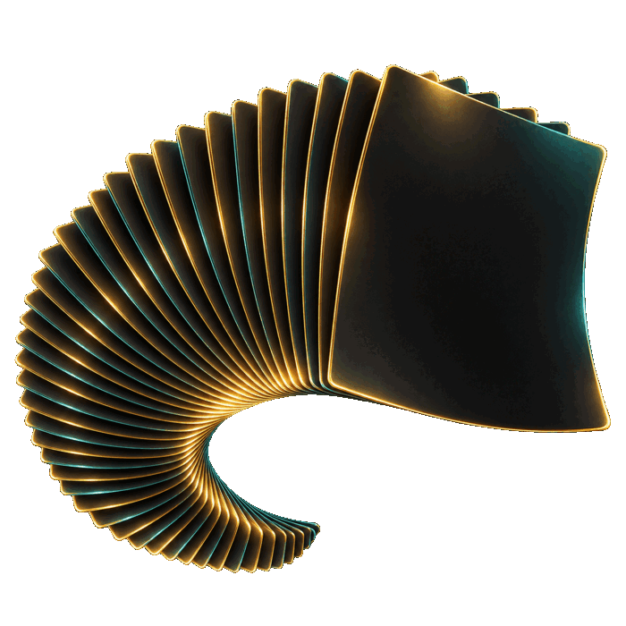
MARK YOUR CALENDAR
Dates to watch
Mon 2 Nov
ARC-AGI-3 Kaggle closes, 23:59 UTC
open models, $700K grand prize at 100%
Tue 3 Nov
EU consultation on copyright and AI
last day for feedback
Mon 30 Nov
Gemini 4 Argon introductory price ends
API doubles to $4 / $20
Thu 3 Dec
EU KIDS Act feedback closes
chatbot rules for children
Mon 7 Dec
Next Deep Dive, 19:30
bring your first agent hour result
40
Notes:
21:09 · 1 min

Slide 41

NEXT
Build your first agent hours with us
Next Deep Dive: Monday, 7 December
Penthouse, Magazinstraße 4, and online
ZukunftUnternehmer Raustruppe
once a month outdoors, for entrepreneurs who think ahead
Colearning and the teen AI team
young people building for real companies
41
Notes:
21:10 · 3 min
Invite people to bring their first agent hour result in December. Mention the WhatsApp group and the hike group.

Slide 42
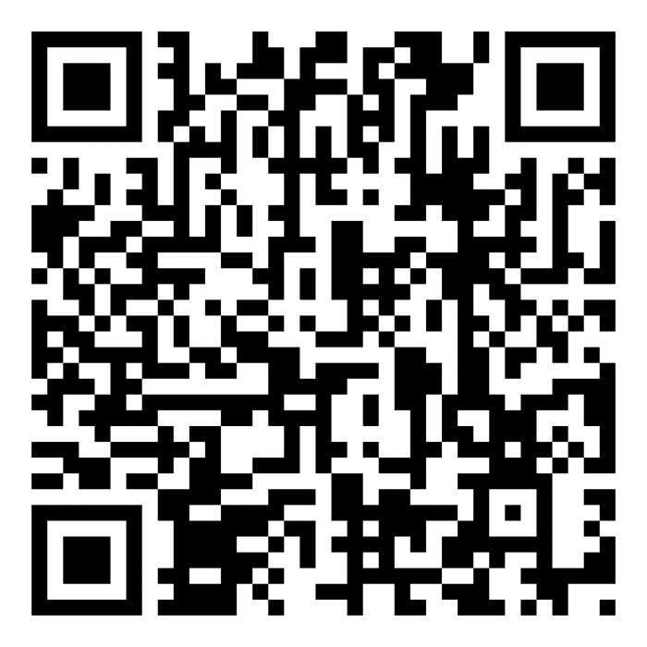

THE TIMELINE, ALL SOURCES AND THE PLAYBOOK
Everything from tonight
zukunftbilden.eu/deepdive/resources/deepdive-2026-11-02
Timeline with every source, the Monday playbook with prompts, prices and the recording after tonight.
Next Deep Dive: Monday, 7 December 2026, 19:30
Momo Maximilian Feichtinger · +43 681 81655313 · office@momofeichtinger.com
42
Notes:
21:13 · open Q&A until 21:30

